Slide 1

Data SCIENCE APPLICATIONS & TOOLS
Submitted to Manpreet Bhatia
Assitant Professor
AAFT ,SODS
Submitted by Anamika Gupta
B.Sc Data Science
AAFT INSTITUTE|SODS|2024

Slide 2
Introduction to Pandas
Pandas is a powerful data manipulation and analysis library for Python.
It provides data structures like Series and DataFrame.
Commonly used for data cleaning, preparation, and analysis in data science.
Key Feature of pandas
DataFrame and Series for handling structured data.
Integrated with NumPy for high-performance data operations.
Supports data alignment and missing data handling.
Provides functions for data manipulation like merging, reshaping, and pivoting.

Slide 3
Working with DataFrames
Creating DataFrames from various data sources (CSV, Excel, SQL, etc.).
Indexing and selecting data using loc and iloc.
Filtering, sorting, and grouping data.
Example code snippet
import pandas as pd
df = pd.read_csv("nba.csv")
df
Data Cleaning and Preparation
Handling missing data with dropna() and fillna().
Removing duplicates with drop_duplicates().
Data transformation using apply() and map().

Slide 4
Advanced Data Analysis
Time series analysis with Pandas.
Merging and joining datasets.
Pivot tables and cross-tabulation.
Visualization with Pandas built-in plotting
Example code snippet
df.plot(kind='line', x='date', y='value')
Series in Pandas
One-dimensional labeled array.
Capable of holding any data type.
import pandas as pd
s = pd.Series([1, 2, 3, 4])
print(s)

Slide 5
DataFrame in Pandas
Two-dimensional labeled data structure.
Columns can be of different types.
.
data = {'A': [1, 2], 'B': [3, 4]}
df = pd.DataFrame(data)
print(df)
Importing Data
Reading data from various sources: CSV, Excel, SQL, JSON, etc.
Data Cleaning
Handling missing data with dropna() and fillna().
Removing duplicates with drop_duplicates().

Slide 6
Introduction to NumPy
NumPy is a fundamental package for scientific computing in Python.
Provides support for large multi-dimensional arrays and matrices.
Offers a collection of mathematical functions to operate on these arrays.
Key Features of NumPy
High-performance array operations.
Broadcasting for arithmetic operations.
Integration with C/C++ and Fortran code.
Tools for linear algebra, random number generation, and more.

Slide 7
NumPy Arrays
ndarray: Core data structure in NumPy.
Creating arrays using array(), zeros(), ones(), and arange().
import numpy as np
a = np.array([1, 2, 3])
print(a)
Array Indexing and Slicing
Accessing elements, subarrays using slicing.
b = a[0:2]
print(b)
Array Operations
Element-wise operations: addition, subtraction, multiplication, division.

Slide 8
Shape Manipulation
Reshaping arrays with reshape(), ravel(), and transpose().
f = a.reshape((3, 1)) print(f)
Numpy for Random Number Generation
Generating random numbers: rand(), randn(), randint().
h = np.random.rand(3) print(h)
Broadcasting
Automatic expansion of arrays for arithmetic operations.

Slide 9
Introduction to Matplotlib
Matplotlib is a comprehensive library for creating static, animated, and interactive visualizations in Python.
It is highly customizable and works well with many data structures, including NumPy arrays and pandas DataFrames.
Key Features of Matplotlib
Wide variety of plot types (line, bar, scatter, histogram, etc.)
Support for LaTeX-style text rendering
Extensive control over plot appearance
Integration with Jupyter Notebooks

Slide 10
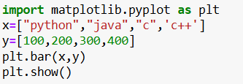
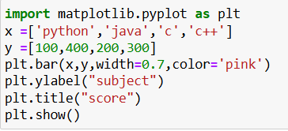
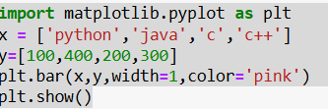
Basic Plotting
Customizing Plots
Creating simple plots using plt.plot()
Line Styles and Colors
Subplots
plt.subplot(2, 1, 1)
plt.plot([1, 2, 3, 4])
plt.subplot(2, 1, 2)
plt.plot([4, 3, 2, 1])
plt.show()

Slide 11
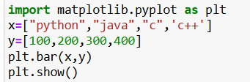
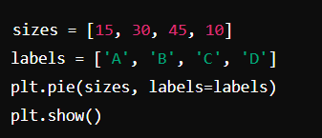
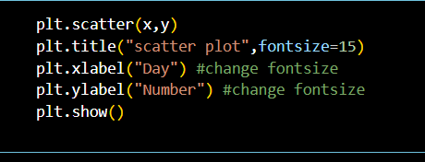
Bar Charts
Creating bar charts using plt.bar()
Histograms
plt.plot([1, 2, 3, 4])
plt.title('My Title’)
plt.xlabel('X-axis Label’)
plt.ylabel('Y-axis Label’)
plt.legend(['Line 1’])
plt.show()
Scatter Plots
Pie ChartsD
Creating scatter plots using plt.scatter()

Slide 12
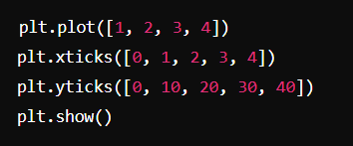
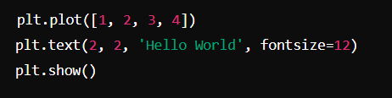
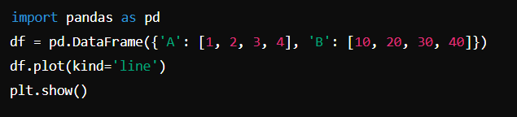

Customizing Ticks
Customizing ticks and tick labels
Adding Text and Annotations
Plotting with Pandas
Scatter plot size increasingg

Slide 13
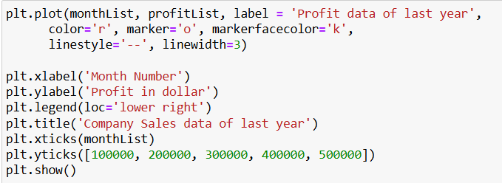
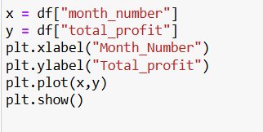
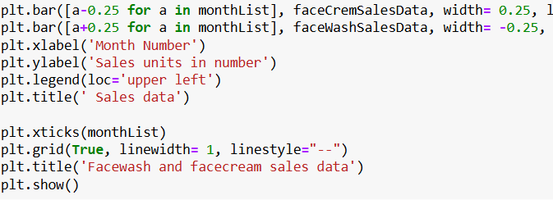
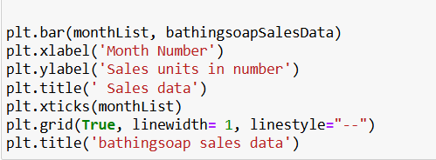
MATPLOTLIB
Graph designing
Distributes data checking
Grid graph
Gried graph with line style

Slide 14
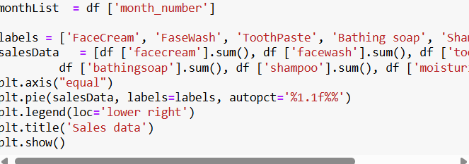
Pie chart
A pie chart is a circular statistical graphic divided into slices to illustrate numerical proportions. Here are some key points about pie charts:
Representation: Each slice of the pie chart represents a category's contribution to the whole. The size of each slice is proportional to the quantity it represents.
Usage: Pie charts are commonly used in business, media, and various fields to show percentage or proportional data. They are particularly useful for displaying data with a small number of categories.

Slide 15
Plotly
What is Plotly?
Creates interactive visualizations for web browsers
Supports various chart types (scatter, line, bar, etc.)
An open-source graphing library for Python
Offers offline and cloud-based deployment options
Why Use Plotly?
Interactivity: Enables user exploration and data manipulation
Customization: Tailors visualizations to your specific needs
Scalability: Handles large datasets efficiently
Wide range of chart types: Caters to different data types

Slide 16
Thank you for your nice attention

